Slide 1

Model of Professional Roles
Vivek Garg
CSVTU Bhilai

Slide 2
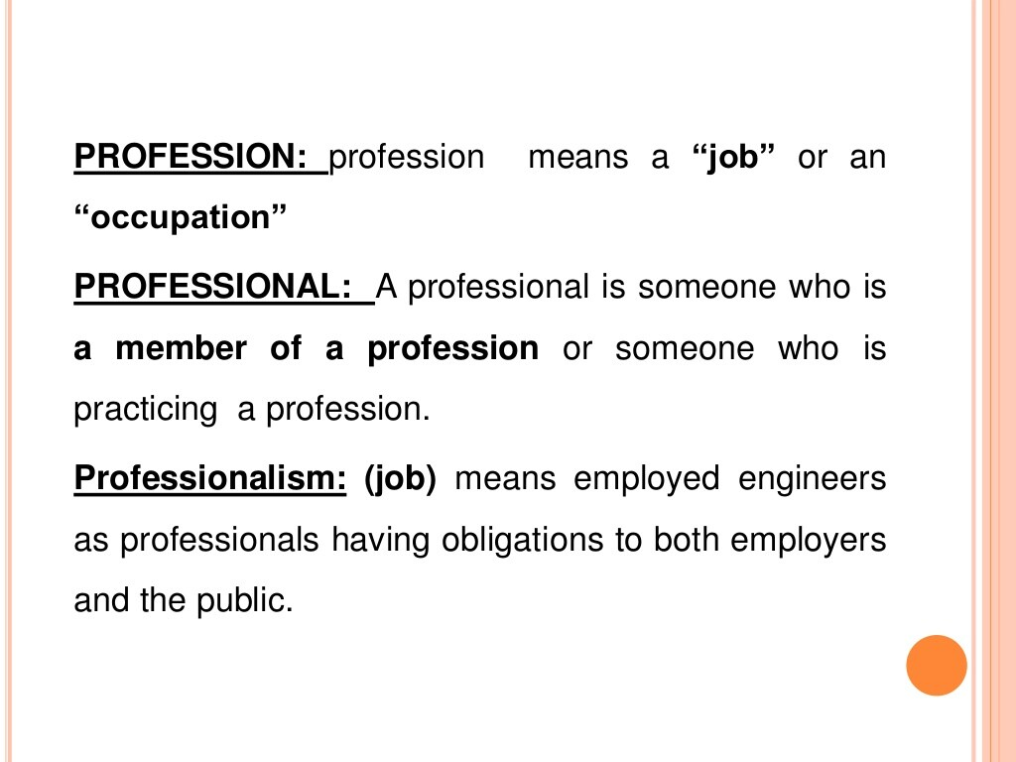

Slide 3
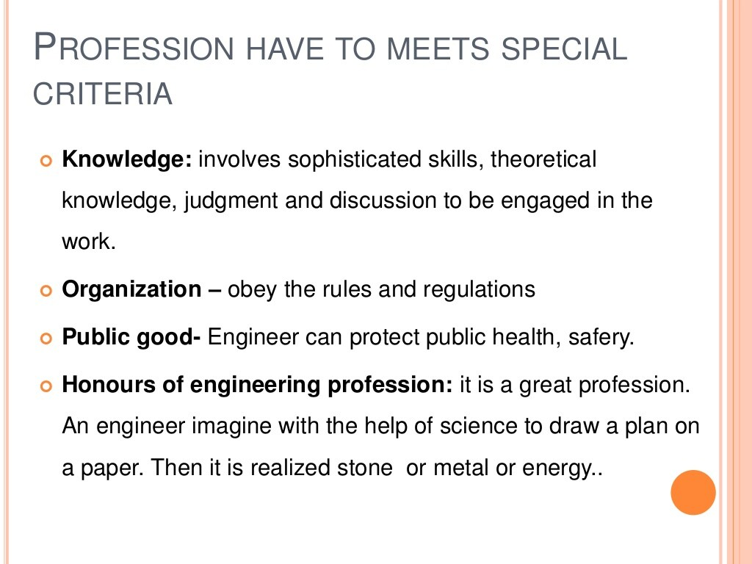

Slide 4
